Slide 1
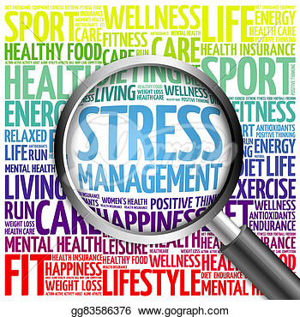
Stress Management
Chapter 3

Slide 2
Bell Ringer
List 10 items that cause stress in your life. Think about them, and rank them in order from most stressful to least stressful.

Slide 3
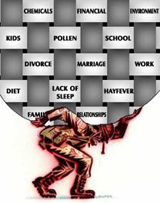
What is Stress?
Stress
Combination of a new or possibly threatening situation and your body’s natural response to the situation
Stressor
Anything that causes a stress response
Physical, Emotional, Mental, or social

Slide 4
Common Stressors for Teens
Arguing with brother or sister
Moving to a new home/ school
Getting glasses or braces
Arguing with a parent
Worrying about height, weight, or appearance
Picked as the lead role in the school play
Seriously injured or sick
Worrying about a family member who is seriously ill
Trying out for a sports team
Death of a family member or pet
Newborn brother or sister
Suspended
Using alcohol, drugs, or tobacco
Getting arrested
Separation or divorce of a parent
Failing classes in school
Starting to date

Slide 5
4 Types of Stressors Activity
Physical | Mental | Social | Emotional
Label 4 columns emotional, mental, physical, and social
Fill in the charts by listing stressors from your bell ringer in the appropriate column

Slide 6
Bad Stress vs. Good Stress
Distress ( Negative Stress)
Negative physical, mental or emotional strain in response to a stressor
Sick; interfere with your life
Examples?
Eustress ( Positive Stress)
Stress response that happens when winning, succeeding, and achieving
Motivates, energizes, and excites you
Examples ?

Slide 7
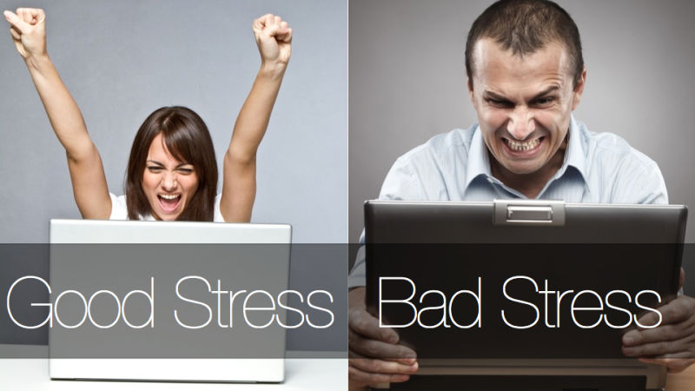
Differences in distress & eustress

Slide 8
Stressors in your Life
Arguing with a brother / sister
Getting glasses or braces
Moving to a new home
Getting in trouble with the teacher
Making a speech in front of the class

Slide 9
Stressor never come one at a time
Major life events
Being pregnant / unmarried
Death of a parent; brother or sister; friend
Parents divorce
Involved with drugs & alcohol
Experiencing a change in your acceptance by your peers

Slide 10
Describe 4 things ( 1 for each) that happen to your physical, mental, emotional, and social health when you are under distress.

Slide 11
Responding to Stressors
Stress Response [ Fight or Flight ] – Body’s reaction to a stressor
https://www.youtube.com/watch?v=mtRrxNTnyh8
When under stress…
More blood goes to the brain
Hearing and vision sharpen
Breathing speeds up
Heart beats faster and harder
Epinephrine release gives an energy boost
More blood goes to the arms and legs

Slide 12
Epinephrine
Epinephrine
Stress hormone that increases your level of sugar in blood and directs the “fight or flight “ response
Hormone
A chemical substance produced by glands that serves as a messenger within your body

Slide 13
Short -Term Responses
Power Surge
Burn off extra energy
Body returns to normal
Feel more relaxed
Body only handles it for a short period of time
** Let your body recover from all the stress **

Slide 14
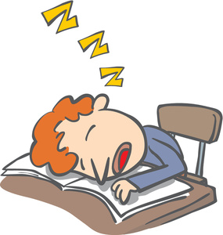
Lasting Effects
Fatigue
Is a feeling of extreme tiredness
Mental Fatigue
Feel tired all over all the time
Lose energy
Physical Fatigue
Body feels tired

Slide 15
Long Term Effects
Brain
Heart
Circulatory system
Immune System
Digestive System
Skin
Weight
Other

Slide 16
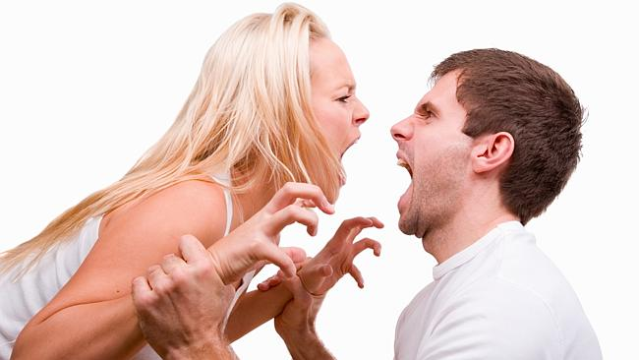
Stress & Relationships
Bad decisions
Inability to think clearly
Emotional

Slide 17
Bell Ringer
Draw a picture of what you think of when you hear the words “ Defense Mechanism”

Slide 18
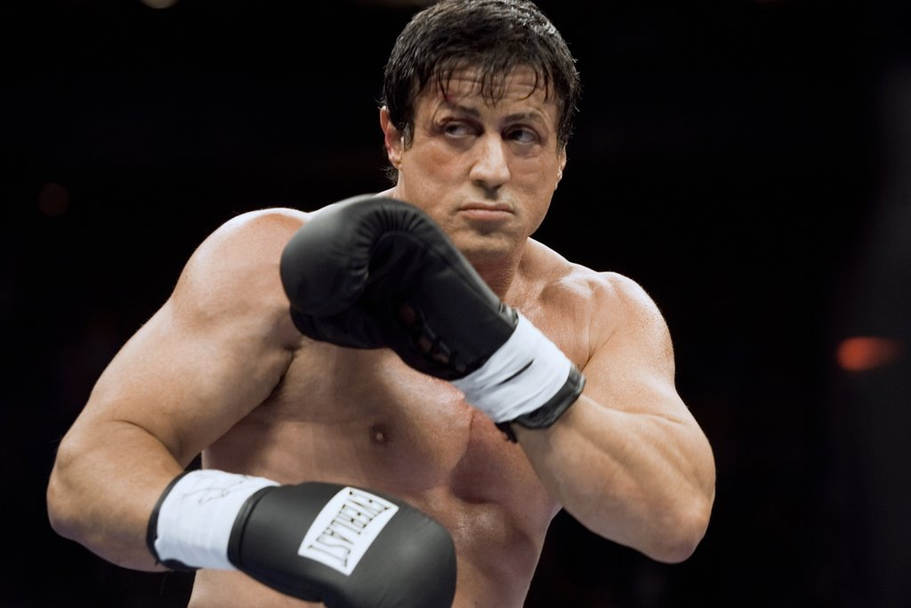
Defense Mechanisms
Defense Mechanism
An automatic, short term behavior to cope with distress

Slide 19
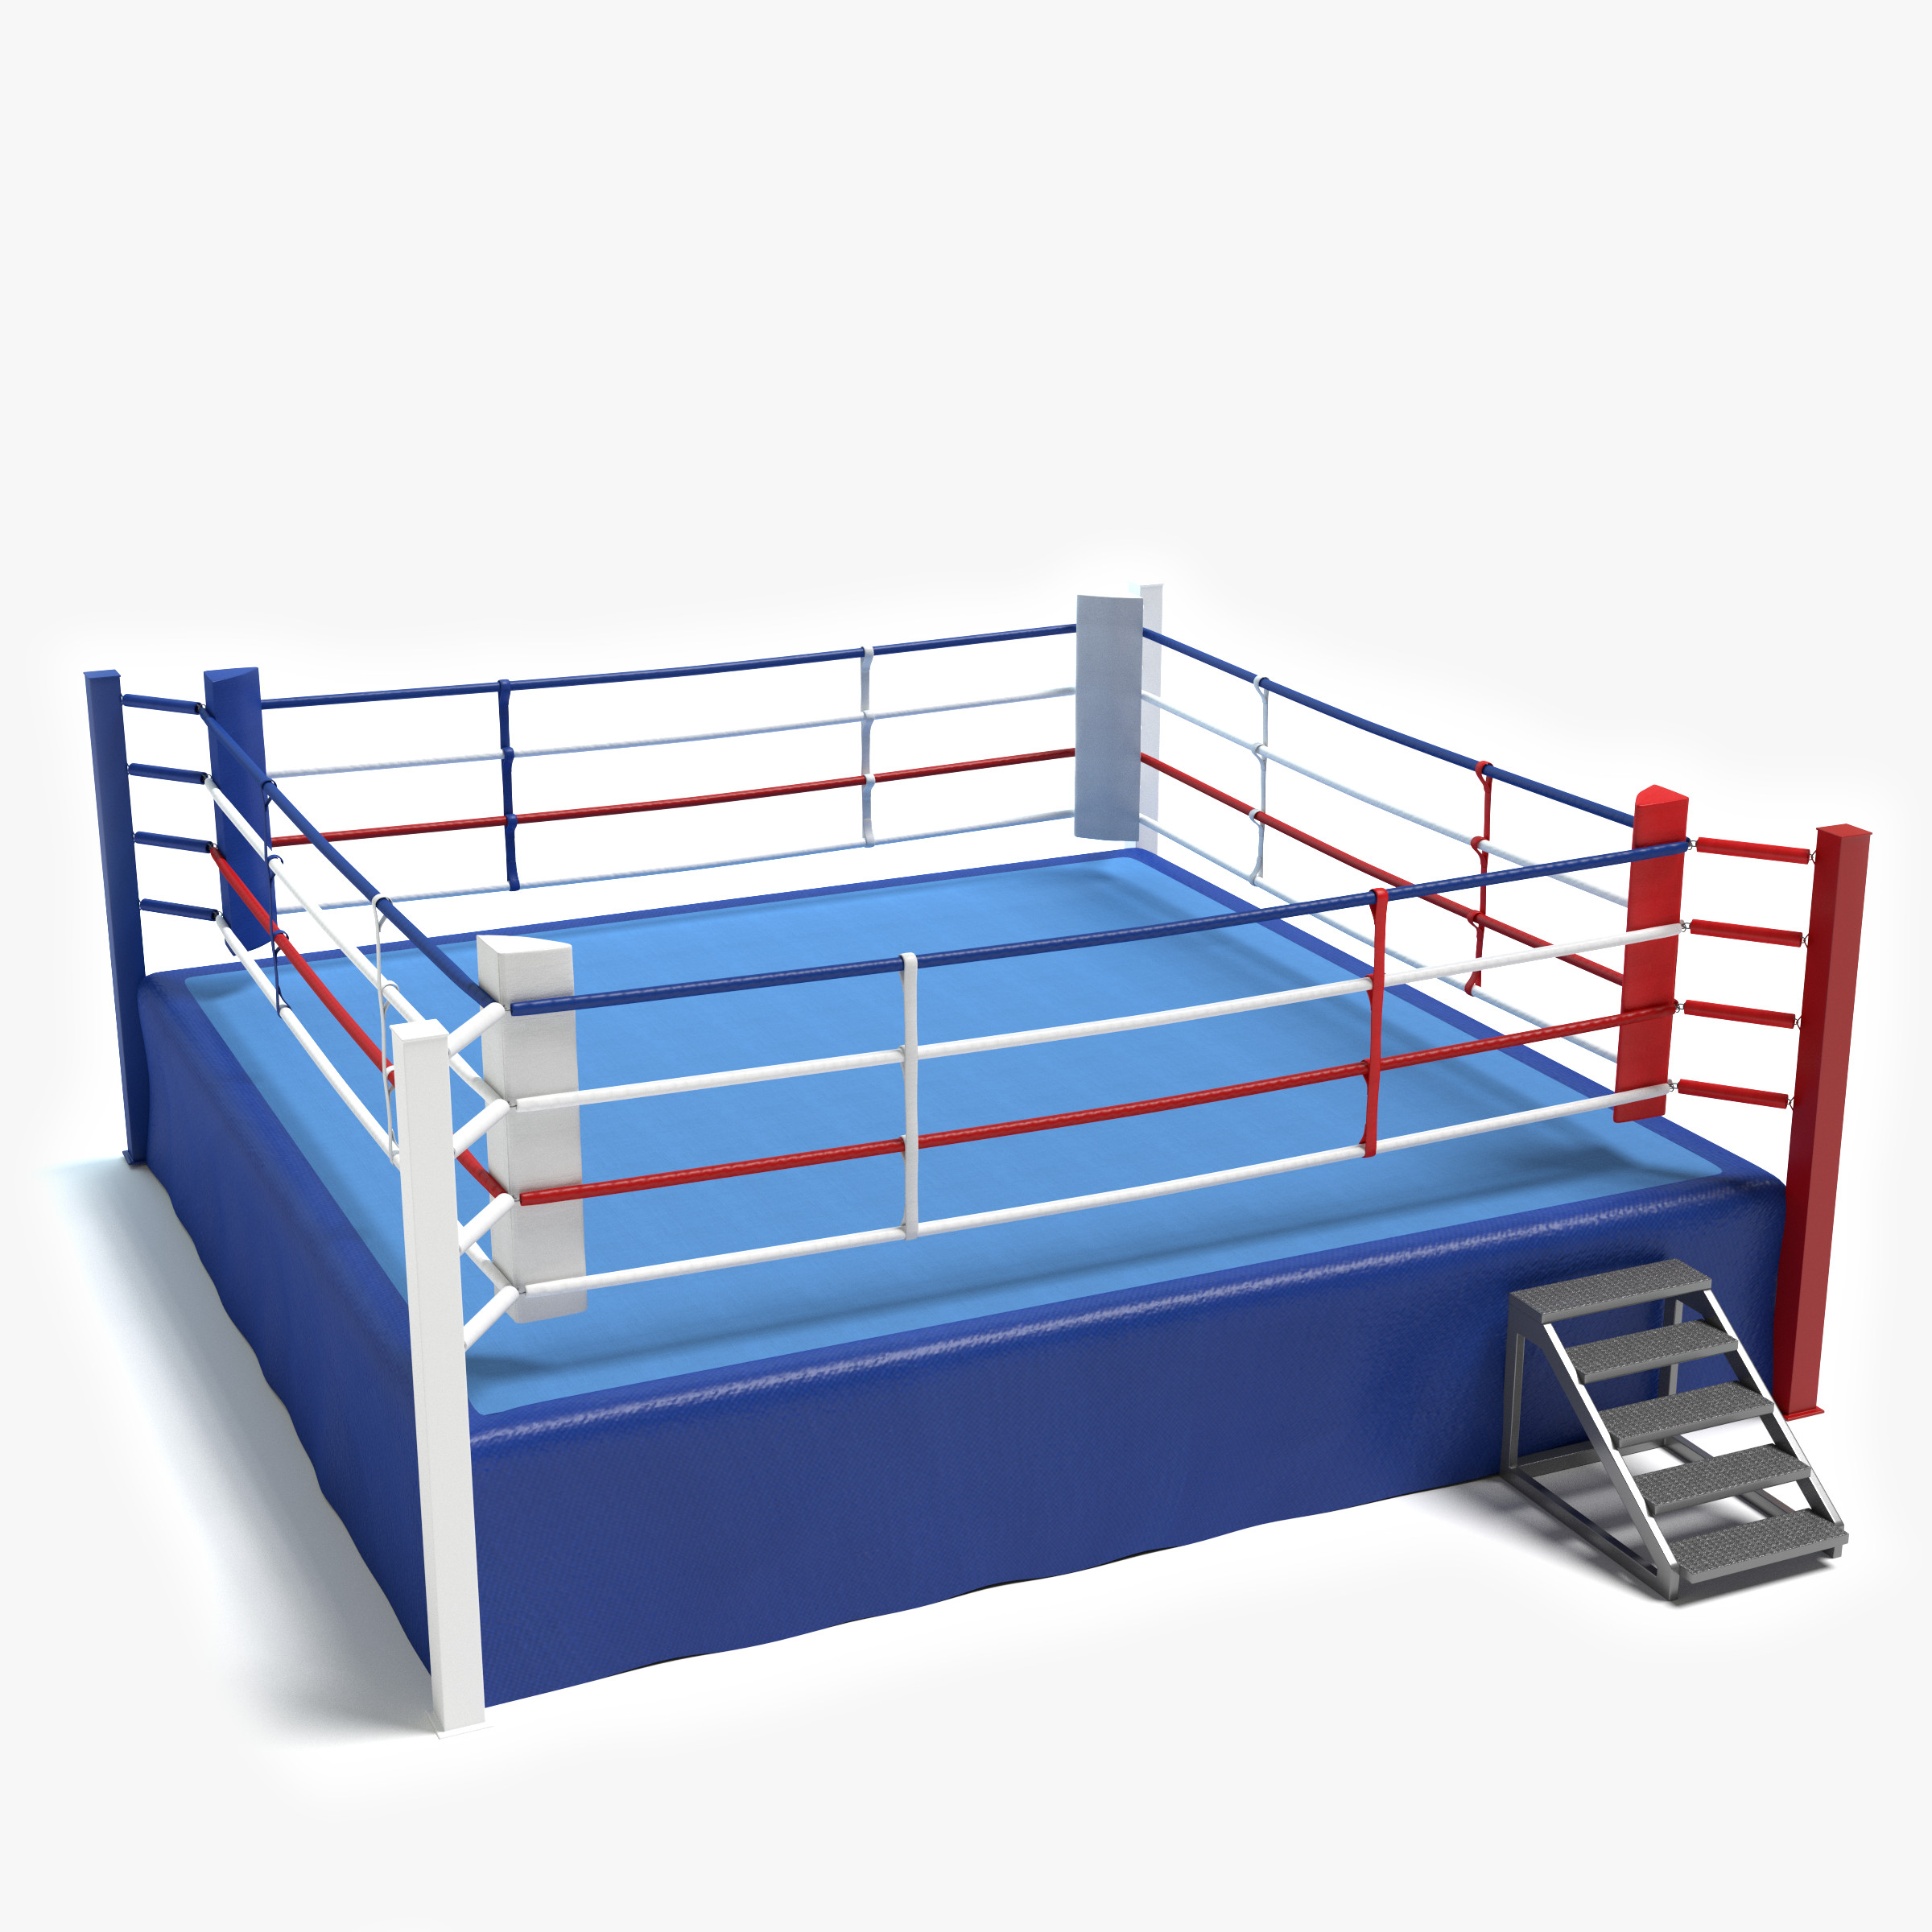
Defense Mechanisms
DO NOT make the stressor go away
Temporary
Easy way out
Delay in having to deal with the stressor
Finding other ways to deal with distress is better

Slide 20
5 Defense Mechanisms
1. Rationalization
2. Displacement
3. Repression
4. Denial
5. Projection

Slide 21
#1
A boss yells at a worker, who feels he cannot yell back, so he goes home yells at his wife and kicks the dog
Defense Mechanism ___________________________________

Slide 22
#2
When Jay backed his car into another car, he blames the other car and says that was the other drivers fault.
Defense Mechanism:___________________________

Slide 23
#3
I trip and fall over in the street. I tell a passerby that I have been recently ill.
Defense Mechanism ____________________

Slide 24
#4
Bonnie is concerned about her boyfriend’s drinking problem. When she asks him about it, he says “ Don’t worry, I have everything under control. The boyfriend is using this
Defense Mechanism _____________________________________________

Slide 25
#5
A man has a phobia of spiders, but cannot remember the first time he was afraid of them
Defense Mechanism : ___________________________

Slide 26
#6
A teenager who is abused by her boyfriend later has no memory of the events, but has trouble forming relationships.
Defense Mechanism ______________________________________________

Slide 27
#7
A teenager fails to get good enough results to get into a chosen university and then says he didn’t want to go there anyway.
Defense Mechanism: _____________________________________________

Slide 28
#8
Reggie overheard what the team was calling him. He channeled his anger, and sacked the quarterback on the next play.
Defense Mechanism _____________________________________________

Slide 29
#9
A man hears his wife is dead, but continues to set the table for her.
Defense Mechanism ______________________________________________

Slide 30
#10
Charlie tripped over his own feet in class. When he got up, he accused the person next to him for tripping him.
Defense Mechanism _____________________________________________

Slide 31
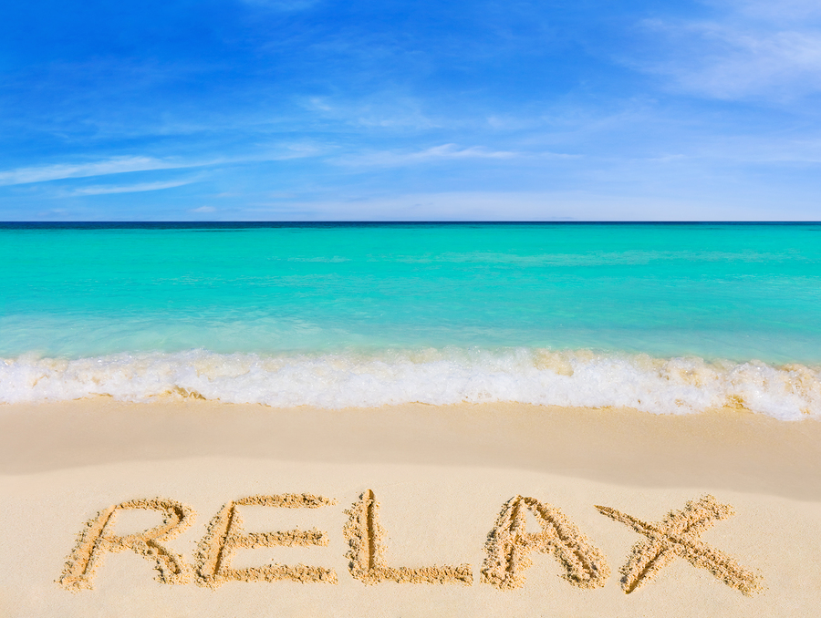
Bell Ringer
Name 5 strategies/ techniques that may reduce stress.

Slide 32
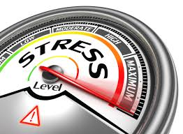
Recognizing Stress
Stress Management
Is the ability to handle stress in healthy ways
Warning Signs
Physical Signs
Mental & Emotional Signs

Slide 33
Handling Stress
Reframing
Changing the way you think about a stressor, and changing your emotional response to the stressor
Asserting Yourself
Planning Ahead
Laughing

Slide 34
6 Ways to Reduce Stress
S.T.R.E.S.S

Slide 35
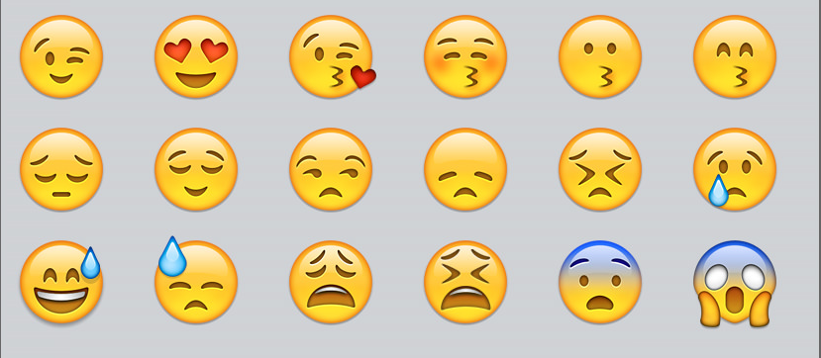
Sharing Emotions
Emotions
Feelings produced as you respond to something in your life
Sharing emotions
Ways to express emotions?
Examples?

Slide 36
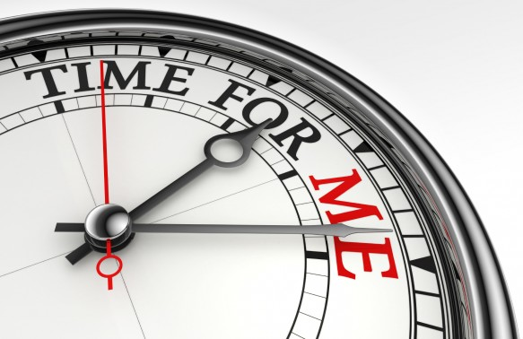
Taking Time for Yourself
30 minutes
Relax

Slide 37
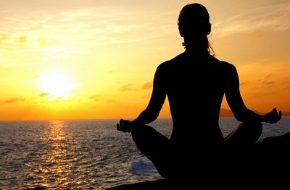
Visualization Meditation
Variation on traditional meditation that requires you not only to employ your visual sense, but also your sense of touch, taste, smell, and hearing.

Slide 38
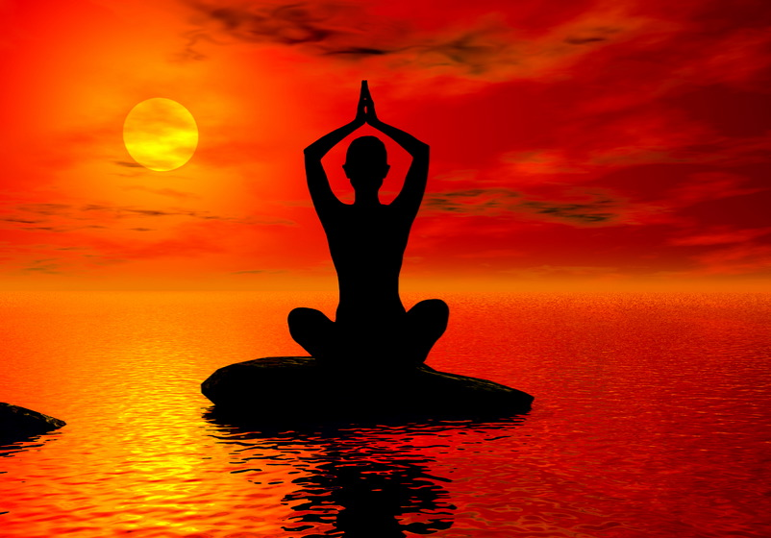
Calming Color Relaxation Visualization
https://www.youtube.com/watch?v=DJUIgV7t8C0

Slide 39
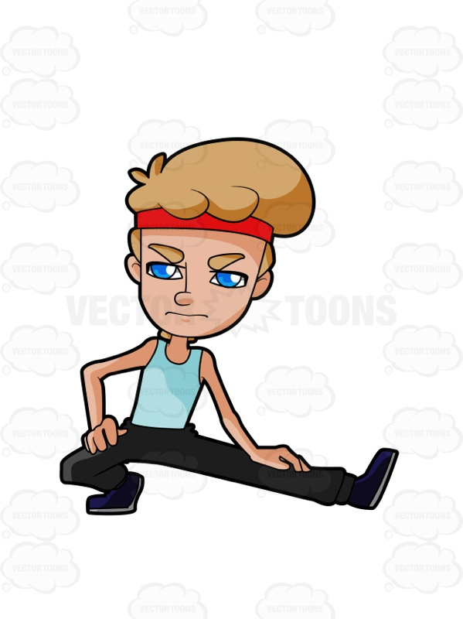
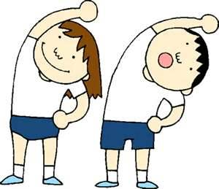
Stretching Activity

Slide 40
Bell Ringer
Create a day schedule for yourselves. Include things such as school, homework, sleep, and activities. Make sure to say how much time you spend in each area above.

Slide 41
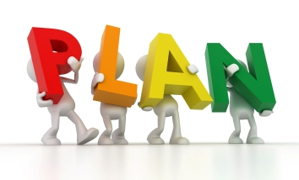
Stopping distress before it starts
Make a “plan”
Any detailed program, created ahead of time, for doing something
Plan Ahead

Slide 42
Tips for preventing stress
Sleep ( 8 hours)
Eating fresh fruits and vegetables
Setting realistic long term and short term goals
Have fun
Believe that every problem has a solution
Laugh
Treating other people with respect ( the way you want to be treated)

Slide 43
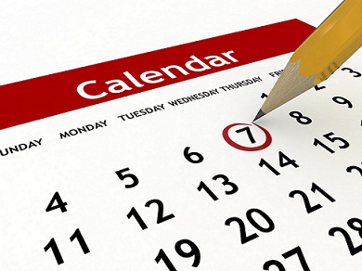
Planning for School
Time Management
Making appropriate choices about how to use your time
Calendars; planners; notebook; schedule
Prioritize
To arrange items in the order of their importance

